Slide 1
CO Project Functions on Numbers
Supervised by Dr/ LAMIA ALREFAAI

Slide 2
Names
 | Mohamed Khaled Ahmed Mohamed
 | Omar Nour Eldin Mohamed Khalil
 | Mohamed Hatem Abd El Menem
 | Mohamed Ahmed Mohamed Asar
 | Kirollos sameh samy

Slide 3
Table of contents
Main Function
Decimal to binary
Factorial
Min, Max,Average,Sum, Sort
nCr Function
Fibonacci Sequence

Slide 4
Main Function
The output of the main function
please Enter either
Number (1): for a min, max, sum, average, sort of digits of an integer
Number (2): for calculating nCr
Number (3): for calculating the factorial of an integer number
Number (4): for calculating the Fibonacci sequence
Number (5): for decimal to binary conversion
Number (6): to quit

Slide 5
Assembly code
#Main Function
.text
main:
li $v0, 4 # Load immediate value 4 into register $v0 (system call code for printing a string)
la $a0, line # Load address of the string "line" into register $a0
syscall # Execute the system call to print the string
li $v0, 4 # Load immediate value 4 into register $v0 (system call code for printing a string)
la $a0, mess1 # Load address of the string "mess1" into register $a0
syscall # Execute the system call to print the string
# Take 1, 2, 3, 4, 5, or 6 from the user.
li $v0, 5 # Load immediate value 5 into register $v0 (system call code for reading an integer)
syscall # Execute the system call to read an integer

Slide 6
Assembly code
beq $v0, 1, func3 # Branch to "func3" if the value in register $v0 is equal to 1
beq $v0, 2, func1 # Branch to "func1" if the value in register $v0 is equal to 2
beq $v0, 3, func4 # Branch to "func4" if the value in register $v0 is equal to 3
beq $v0, 4, func2 # Branch to "func2" if the value in register $v0 is equal to 4
beq $v0, 5, func5 # Branch to "func5" if the value in register $v0 is equal to 5
beq $v0, 6, quit # Branch to "quit" if the value in register $v0 is equal to 6
invalid: # Label for the invalid option
li $v0, 4 # Load immediate value 4 into register $v0 (system call code for printing a string)
la $a0, valid1 # Load address of the string "valid1" into register $a0
syscall # Execute the system call to print the string
j main # Unconditional jump to the "main" label (to start the main part of the program)

Slide 7
Factorial
The output of the factorial function
please Enter either
Number (1): for a min, max, sum, average, sort of digits of an integer
Number (2): for calculating nCr
Number (3): for calculating the factorial of an integer number
Number (4): for calculating the Fibonacci sequence
Number (5): for decimal to binary conversion
Number (6): to quit
3
Enter a number to find its factorial: 4
The factorial of a number is 24

Slide 8
C Code
#include <stdio.h>
int factorial(int n);
int main() {
int n;
printf("Enter a positive integer: ");
scanf("%d", &n);
printf("Factorial of %d = %d", n, factorial(n));
return 0;
}
int factorial(int n) {
if(n > 1)
return n * factorial(n - 1);
else
return 1;
}

Slide 9
Assembly code
#Call the factorial function. lw $a0, theNumber # Load the value from memory location "theNumber" into register $a0 (function argument) jal findFactorial # Jump and link to the "findFactorial" function sw $v0, theAnswer # Store the result of the factorial function in the memory location "theAnswer" # Display the results. li $v0, 4 # Load immediate value 4 into register $v0 (system call code for printing a string) la $a0, resultMassege # Load address of the string "resultMessage" into register $a0 syscall # Execute the system call to print the string li $v0, 1 # Load immediate value 1 into register $v0 (system call code for printing an integer) lw $a0, theAnswer # Load the value from memory location "theAnswer" into register $a0 (function argument) syscall # Execute the system call to print the integer
#Factorial
func4:
.text
li $v0, 4 # Load immediate value 4 into register $v0 (system call code for printing a string)
la $a0, popMessage # Load address of the string "popMessage" into register $a0
syscall # Execute the system call to print the string
li $v0, 5 # Load immediate value 5 into register $v0 (system call code for reading an integer)
syscall # Execute the system call to read an integer
sw $v0, theNumber # Store the read integer value into the memory location "theNumber"

Slide 10
Assembly code
# Base case. li $v0, 1 # Load immediate value 1 into register $v0 (base case for factorial) beq $a0, 0, factorialDone # Branch to "factorialDone" if the value in register $a0 is equal to 0 move $s0, $a0 # Move the value in register $a0 to register $s0 (current factorial value) sub $a0, $a0, 1 # Subtract 1 from the value in register $a0 (decrement for recursive call) jal findFactorial # Jump and link to the "findFactorial" function (recursive call) mul $v0, $s0, $v0 # Multiply the value in register $s0 (current factorial value) with the return value ($v0) of the recursive call
# Tell the OS that this is the end of the program.
li $v0, 10 # Load immediate value 10 into register $v0 (system call code for program termination)
syscall # Execute the system call to terminate the program
.globl findFactorial
findFactorial:
subu $sp, $sp, 8 # Subtract 8 from the stack pointer to allocate space for the return address and saved registers
sw $ra, ($sp) # Save the return address on the stack
sw $s0, 4($sp) # Save the value of register $s0 on the stack

Slide 11
Assembly code
factorialDone:
lw $ra, ($sp) # Load the return address from the stack into register $ra
lw $s0, 4($sp) # Load the value of register $s0 from the stack
addu $sp, $sp, 8 # Add 8 to the stack pointer
# Return from factorial.
jr $ra # Jump to the address stored in register $ra (return from the function)
j main # Unconditional jump to the "main" label (to start the main part of the program)

Slide 12
nCr Function
The output of the factorial function
please Enter either
Number (1): for a min, max, sum, average, sort of digits of an integer
Number (2): for calculating nCr
Number (3): for calculating the factorial of an integer number
Number (4): for calculating the Fibonacci sequence
Number (5): for decimal to binary conversion
Number (6): to quit
2
Enter n: 8
Enter r: 4
8C4 = 70

Slide 13
C Code
int overflow(int val){
int MAX = INT_MAX;
return(val > MAX || val < 1);
}
void check(int n , int *r){
if(*r > n/2)
*r = n - *r;
}
int nPr(int n, int r){
int npr = 1;
for(int i = 0; i < r; i++){
npr *= n;
if(overflow(npr))
return -1;
n--;
}
return npr;
}
int nCr(int n, int r){
check(n, &r);
int npr = nPr(n, r);
int rpr = nPr(r, r);
if(npr == -1 || rpr == -1)
return -1;
return npr / rpr;
}
int invalid(int n, int r){
return (n < r) || (n < 0) || (r < 0);
}

Slide 14
C Code
int main() {
int n, r;
printf("Enter the value of n: ");
scanf("%d", &n);
printf("Enter the value of r: ");
scanf("%d", &r);
if(invalid(n, r)){
printf("Invalid input\n");
return 1;
}
int ncr = nCr(n, r);
if(ncr == -1){
printf("Out of range\n");
return 0;
}
printf("nCr(%d, %d) = %d\n", n, r, ncr);
return 0;
}

Slide 15
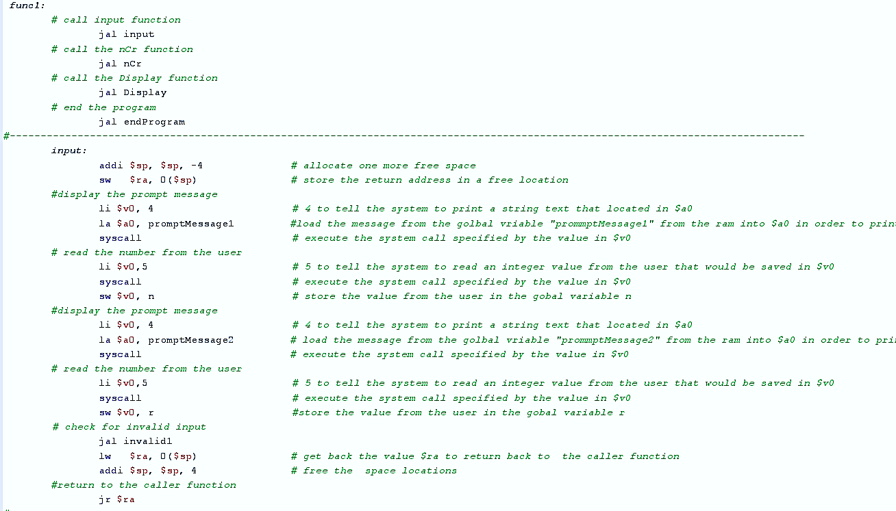
Assembly code

Slide 16
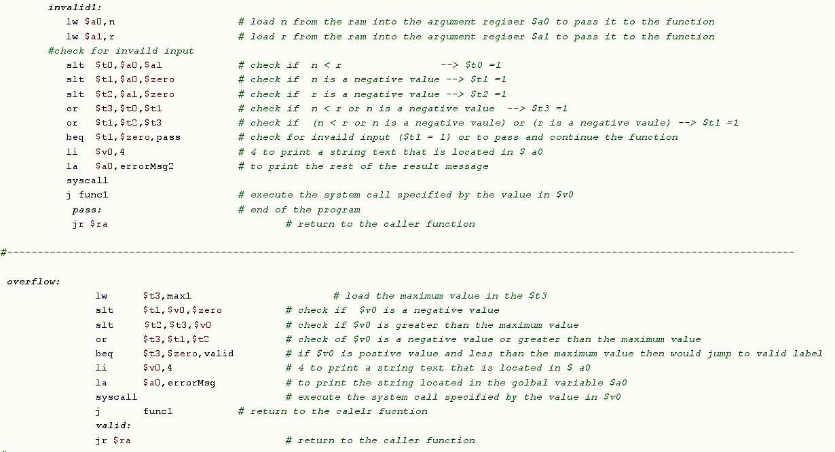
Assembly code

Slide 17
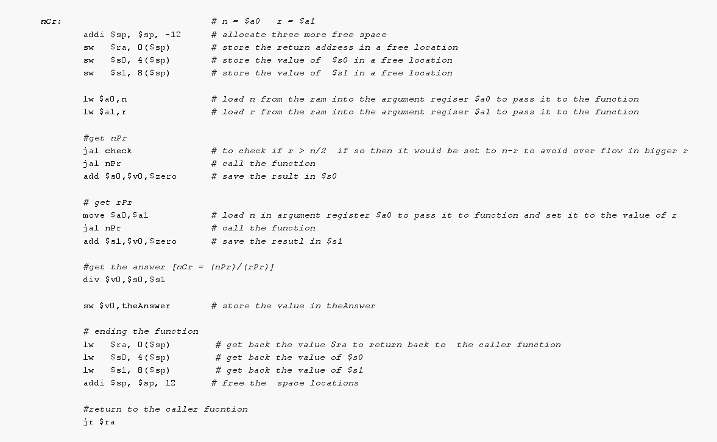
Assembly code

Slide 18
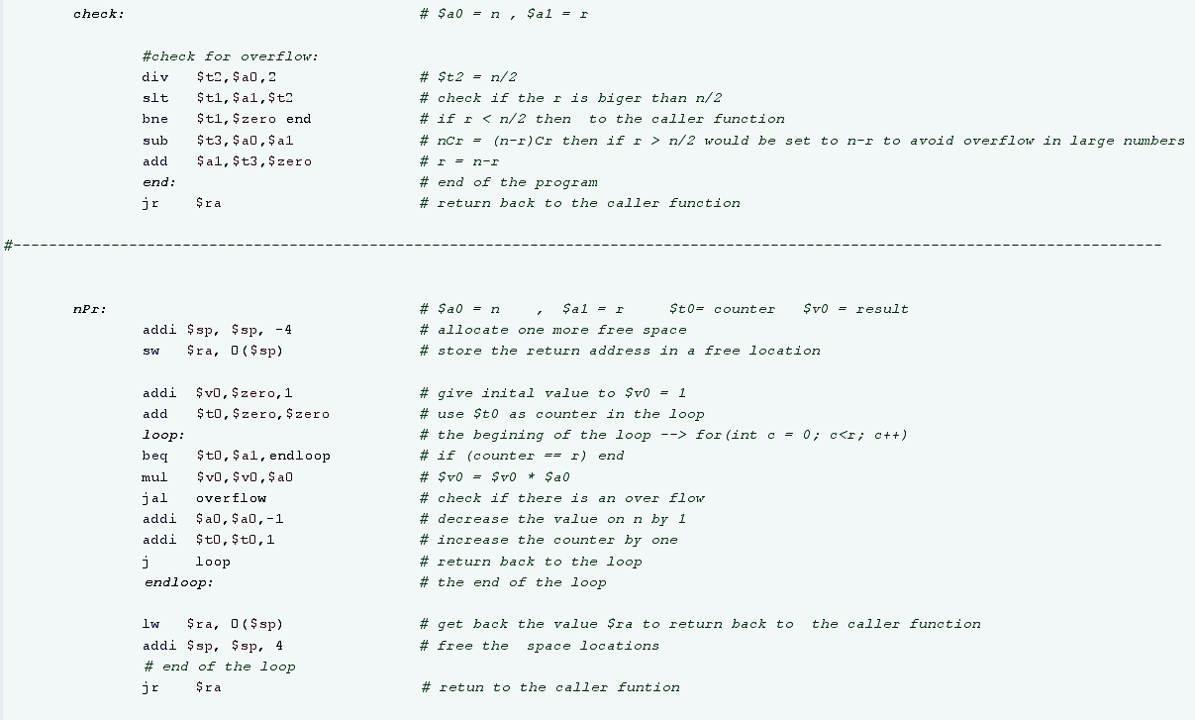
Assembly code

Slide 19
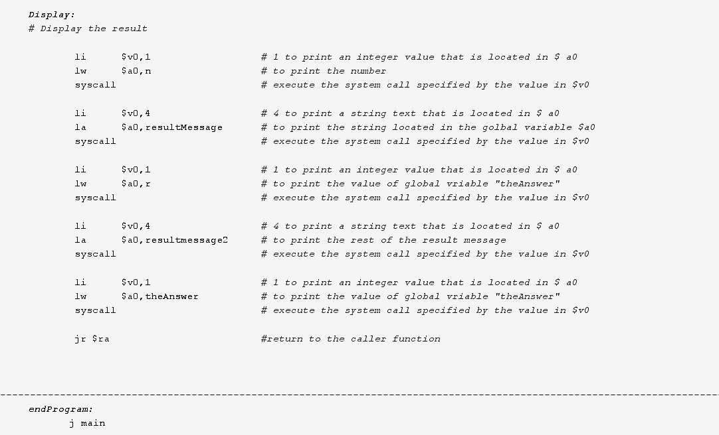
Assembly code

Slide 20
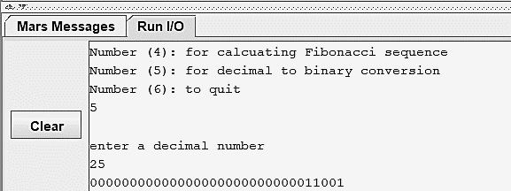
Decimal to binary Conversion Function
The output of the factorial function

Slide 21
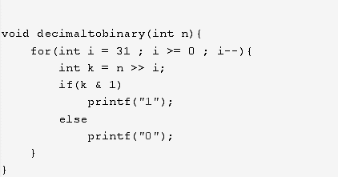
C Code

Slide 22
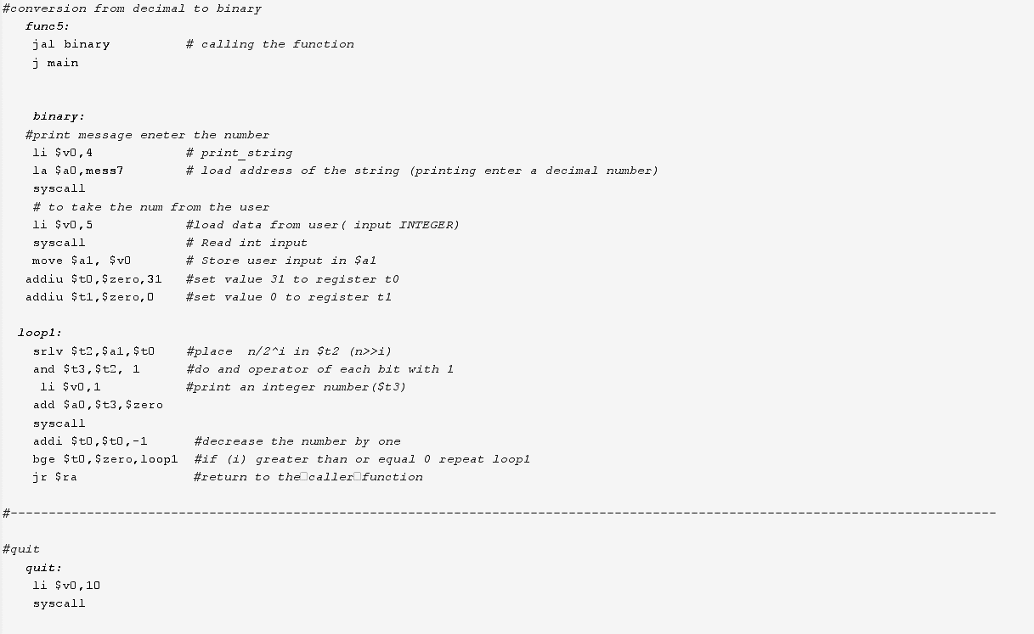
Assembly code

Slide 23
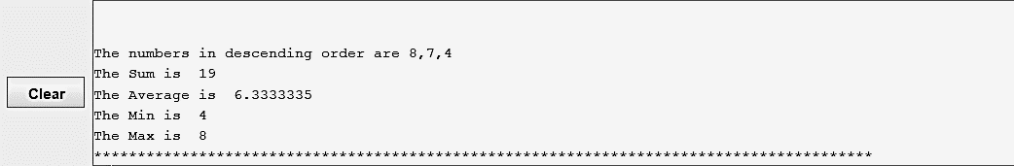
Min, Max, Sum, Average, Sort Functions
The output of the Math functions

Slide 24
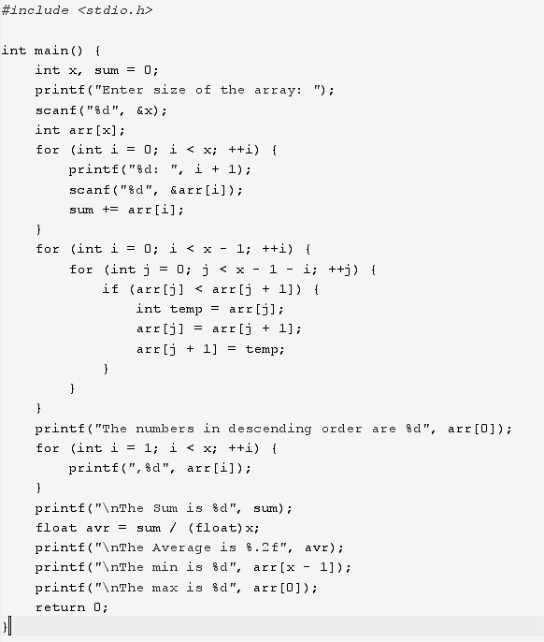
C Code

Slide 25
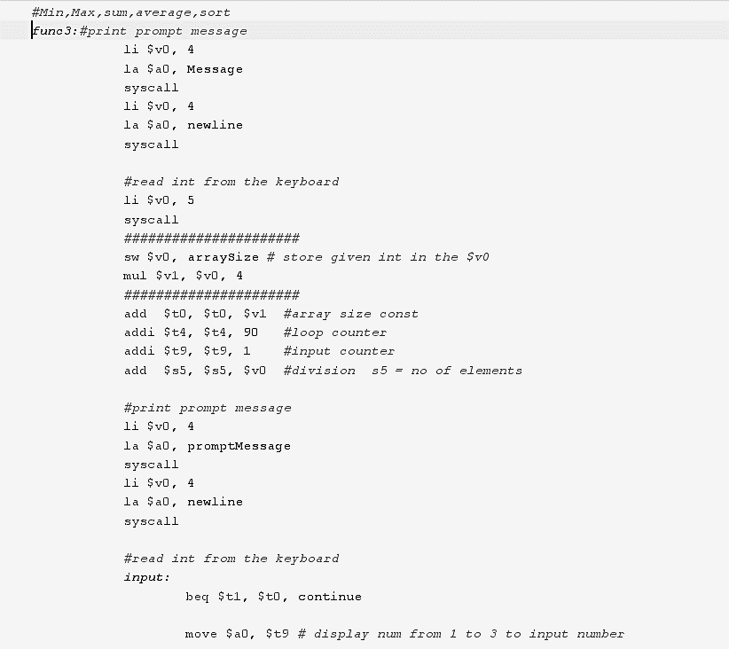
Assembly code

Slide 26
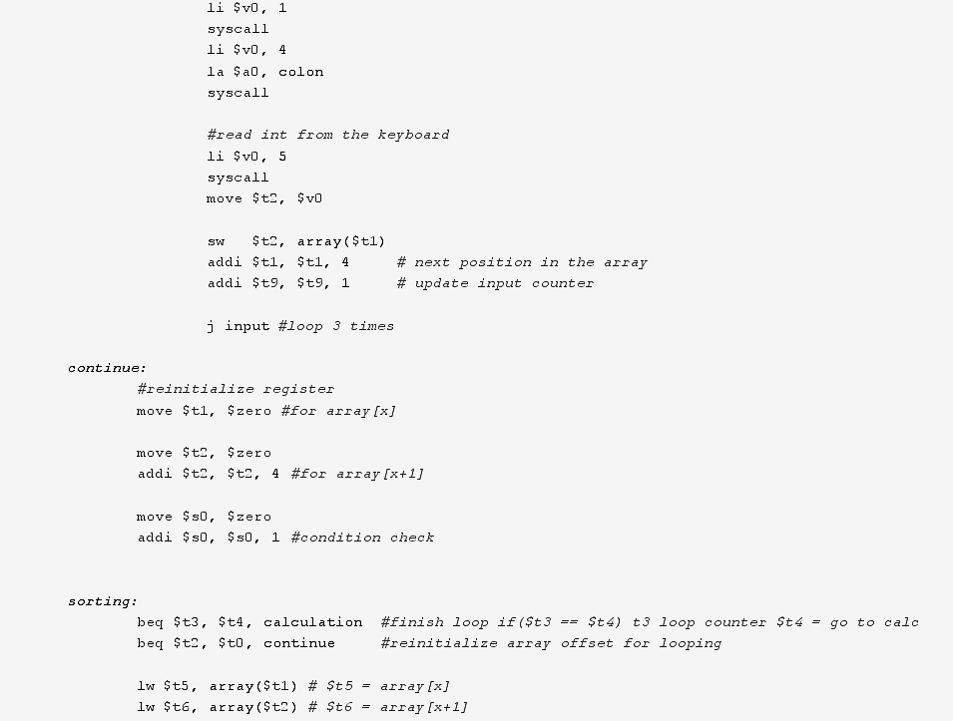
Assembly code

Slide 27
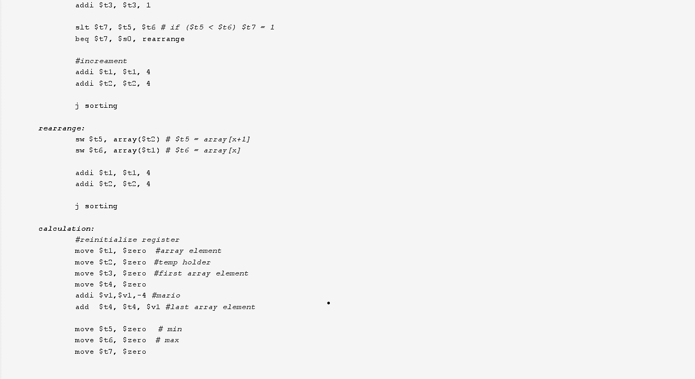
Assembly code

Slide 28
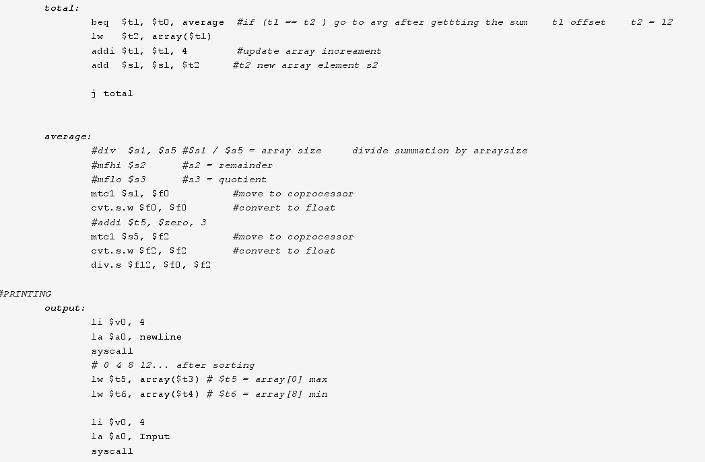
Assembly code

Slide 29
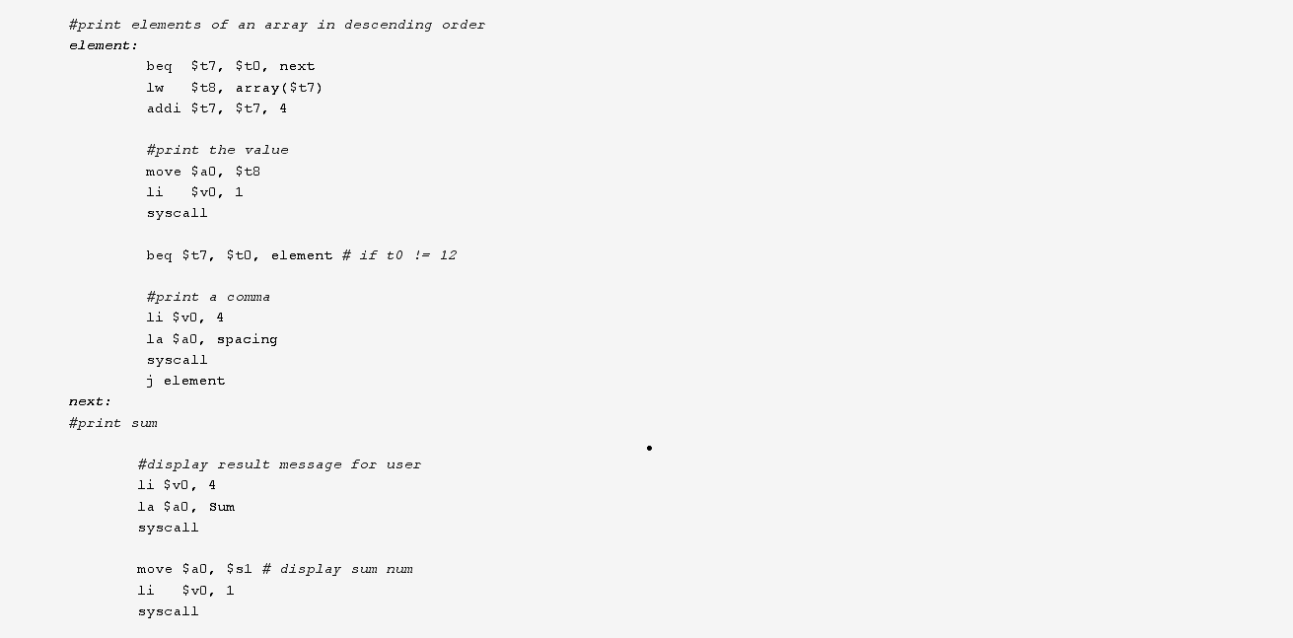
Assembly code

Slide 30
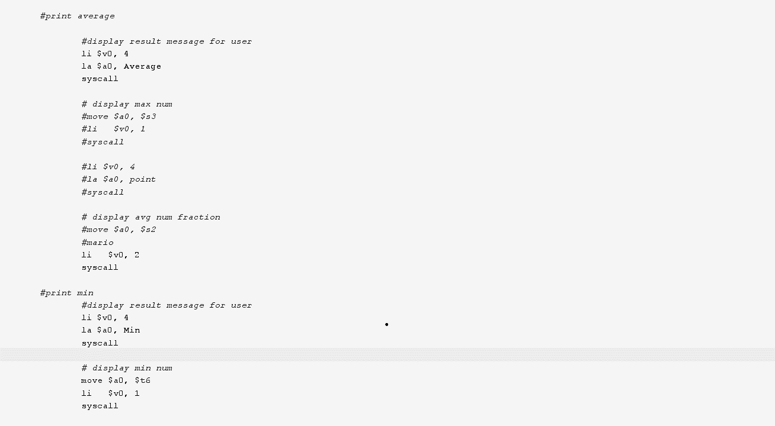
Assembly code

Slide 31
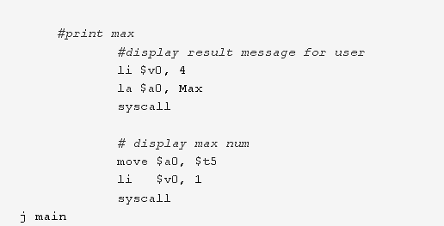
Assembly code

Slide 32
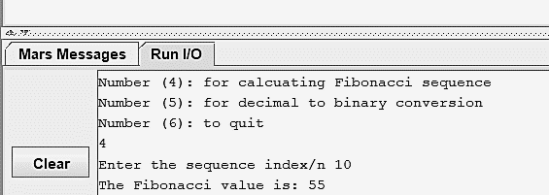
Fibonacci Sequence
The output of the Fibonacci sequence

Slide 33
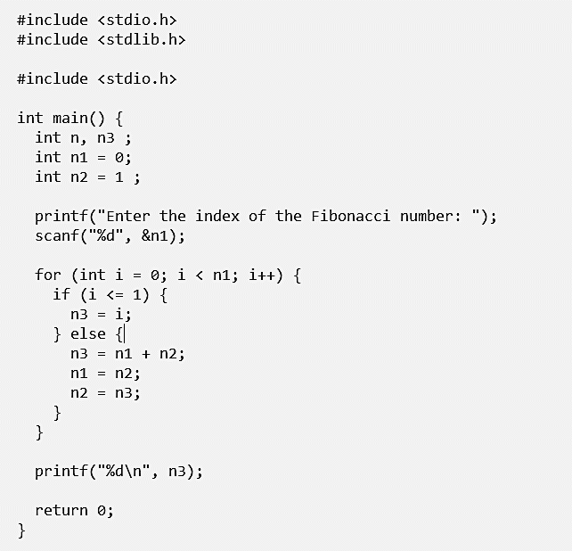
C Code

Slide 34
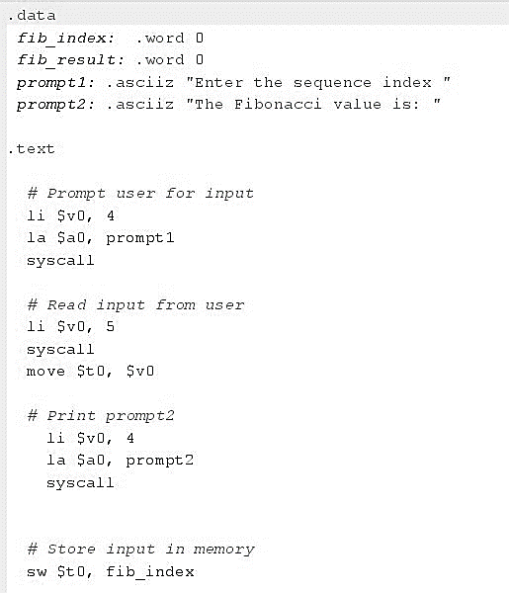
Assembly code

Slide 35
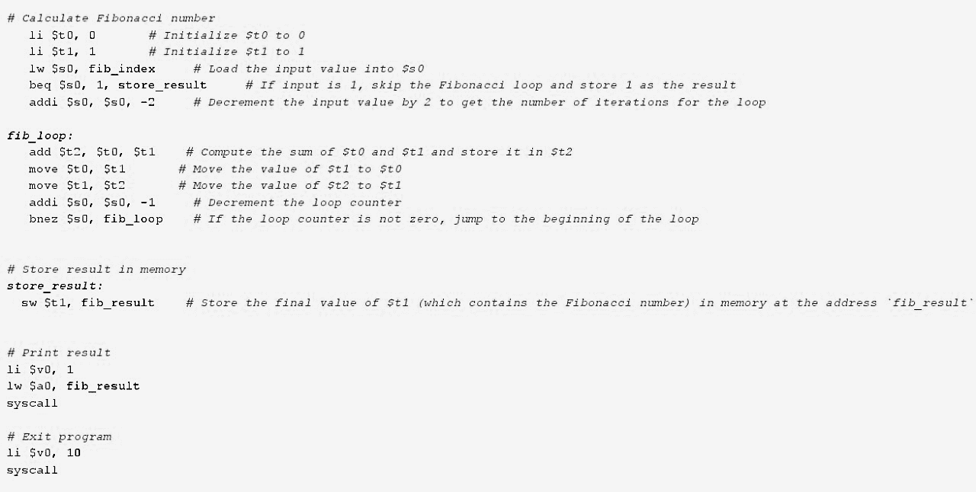
Assembly code

Slide 36
Thank you!

